Slide 1
The Edinburgh Postnatal Depression Scale:
Screening for Depression and Anxiety
Delreen Schmidt-Lenz, MSW, LCSW, I/ECMH-C
MIECHV Project Lead, Infant & Early Childhood Mental Health Consultation Project
July 2026
This project is supported by the Health Resources and Services Administration (HRSA) of the United States Department of Health and Human Services (HHS) under Grant Number X1053621 and Grant Number X1055020 in the total award amounts of $11,942,558 and $13,126,310, respectively, for the Maternal, Infant and Early Childhood Home Visiting Program, and 0% financed with nongovernmental sources. This information or content and conclusions are those of the author and should not be construed as the official position or policy of, nor should any endorsements be inferred by HRSA, HHS or the United States Government.
Notes:
The Edinburgh Postnatal Depression Scale: Screening for Depression and Anxiety was created by Delreen Schmidt-Lenz, MSW, LCSW, I/ECMH-C, MIECHV Project Lead, Infant & Early Childhood Mental Health Consultation Project - July 2026
HRSA Language, Effective Date: 10.01.25 (Based on email from R. Chaney-Jones)
This project is supported by the Health Resources and Services Administration (HRSA) of the United States Department of Health and Human Services (HHS) under Grant Number X1053621 and Grant Number X1055020 in the total award amounts of $11,942,558 and $13,126,310, respectively, for the Maternal, Infant and Early Childhood Home Visiting Program, and 0% financed with nongovernmental sources. This information or content and conclusions are those of the author and should not be construed as the official position or policy of, nor should any endorsements be inferred by HRSA, HHS or the United States Government.
NOTE:
To ensure fidelity, information for this training was derived directly from the following HRSA document: “Updates to FY2027 MIECHV Performance Measures: Implementing the New Anxiety Screening and Completed Referral Measure: TA Tool for Anxiety Screening (01.30.26) FINAL”

Slide 2
Overview
  New HRSA FY ‘27 Program Performance Measure
  Peripartum/Postpartum Depression
  Peripartum/Postpartum Anxiety
  Edinburgh Postnatal Depression Scale
  Edinburgh Postnatal Depression Scale: Anxiety Subset
  Resources
  References
Notes:
Overview:
An overview of the topics discussed in this training are as follows:
New FY ‘27 Program Performance Measure
Peripartum/Postpartum Depression
Peripartum/Postpartum Anxiety
Edinburgh Postnatal Depression Scale
Edinburgh Postnatal Depression Scale: Anxiety Subset
Resources
References

Slide 3
HRSA’s New Program Performance Measure in FY ’27 Addresses Anxiety
A New Sub-Measure to Screen for Anxiety is Being Added Under The Existing Performance Measurement Framework
Prevalence:
Anxiety is often as prevalent as, or more prevalent than, depression in the postpartum period.
Co-Morbidity:
Anxiety and depression frequently co-occur, and screening for only one may lead to under-diagnosis and missed opportunities for intervention.
System Alignment:
This aligns with updated clinical guidelines which recommend universal anxiety screening for pregnant and postpartum individuals.
Notes:
For Fiscal Year 2027 (FY27), the Health Resources and Services Administration (HRSA) has introduced an update to a Maternal, Infant, and Early Childhood Home Visiting (MIECHV) program performance measure, specifically targeting anxiety.
→ The primary change is an addition of a new sub-measure for anxiety screening under the existing performance measurement framework.
Rationale for the Change
The inclusion of anxiety reflects a shift toward a more comprehensive view of Perinatal Mood and Anxiety Disorders (PMADs), per HRSA, to highlight the following:
Prevalence: Anxiety is often as prevalent as, or more prevalent than, depression in the postpartum period.
Co-Morbidity: Anxiety and depression frequently co-occur, and screening for only one may lead to under-diagnosis and missed opportunities for intervention.
System Alignment: This aligns with updated clinical guidelines from the American College of Obstetricians and Gynecologists (ACOG) and the Women’s Preventive Services Initiative (WPSI), both of which recommend universal anxiety screening for pregnant and postpartum individuals.
Reference: https://docs.google.com/document/u/0/d/1Y6cdSMsprPFRU1UcISSSnwrej7tgblyaG7Lh4TVTQFw/mobilebasic?usp=gmail

Slide 4
Effective October 1, 2026:
All Primary Caregivers
Will Be Screened for Depression and Anxiety
1
Screen
2
Refer / Follow-Up
All primary caregivers will be screened for depression and anxiety within 3 months of delivery (if enrolled prenatally) or of enrollment (all other caregivers).
Screen every eligible caregiver — even those already receiving mental health services or treatment.
Caregivers with a positive screen for depression and/or anxiety should be referred to appropriate services — for each condition, respectively.
Follow up should occur to ensure caregivers received the recommended services.
Referral services may be the same for depression and anxiety.
Edinburgh Postnatal Depression Scale | Anxiety Screening Update
5
Notes:
Starting on October 1, 2026, HRSA expects that all primary caregivers will be screened for depression and anxiety within 3 months of delivery (if enrolled prenatally) or enrollment (for all other caregivers). All caregivers that meet the eligibility criteria should be screened, even if they are already receiving mental health services or treatment (this will be mirrored in Form 2 and the Form 2 Toolkit). Additionally, caregivers who have a positive screen for depression and/or anxiety should be referred to appropriate services for depression and/or anxiety, respectively, and then followed up to ensure they received recommended services. Referral services might be the same for depression and anxiety.
Reference:
“Updates to FY2027 MIECHV Performance Measures: Implementing the New Anxiety Screening and Completed Referral Measure: TA Tool for Anxiety Screening (01.30.26) FINAL”

Slide 5
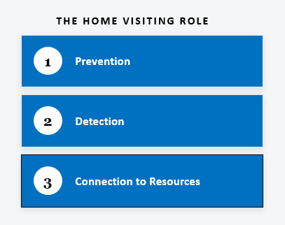
The Importance and Relevance of Screening and Referring for Anxiety:
Caregiver Well-Being
Shapes A Child’s Earliest Years
Perinatal mental health disorders are common — and treatable.
Home visitors are well positioned to screen caregivers and connect them to appropriate services.
The workforce is a critical layer of prevention, detection, and early intervention.
Edinburgh Postnatal Depression Scale | Anxiety Screening Update
2
Notes:
The Importance and Relevance of Screening and Referring Caregivers for Anxiety:
“Supporting caregiver well-being is essential in children’s earliest years. Mental health affects adults’ ability to maintain healthy relationships, work, and manage stress, and directly impacts children’s growth and development. Mental health disorders, including perinatal mental health disorders, are common and treatable.
{The} home visiting workforce provides a critical layer of prevention, detection, and connection to early intervention to improve the health and well-being of parents, children, and families. Home visitors are well positioned to screen caregivers for mental health disorders and connect them to appropriate services.
Since October 2016, MIECHV awardees have reported program performance on caregiver depression screening and completed depression referrals.”
Reference:
“Updates to FY2027 MIECHV Performance Measures: Implementing the New Anxiety Screening and Completed Referral Measure: TA Tool for Anxiety Screening (01.30.26) FINAL”

Slide 6
Anxiety Is Common —
And Often Undetected
Anxiety is Distinct from Depression.
Anxiety can significantly affect parenting, early relationships, and children’s development — so both conditions warrant screening.
Notes:
“Anxiety is common among parents during the perinatal and early childhood years. However, it often goes undetected because anxiety is less routinely screened for than depression despite its prevalence and link to child and family outcomes. Clinical practice guidelines now recommend screening adults, including pregnant and postpartum women, for depression and anxiety. Because anxiety is both common and distinct from depression—and can significantly affect parenting, early relationships, and children’s development.”
Reference:
“Updates to FY2027 MIECHV Performance Measures: Implementing the New Anxiety Screening and Completed Referral Measure: TA Tool for Anxiety Screening (01.30.26) FINAL”

Slide 7
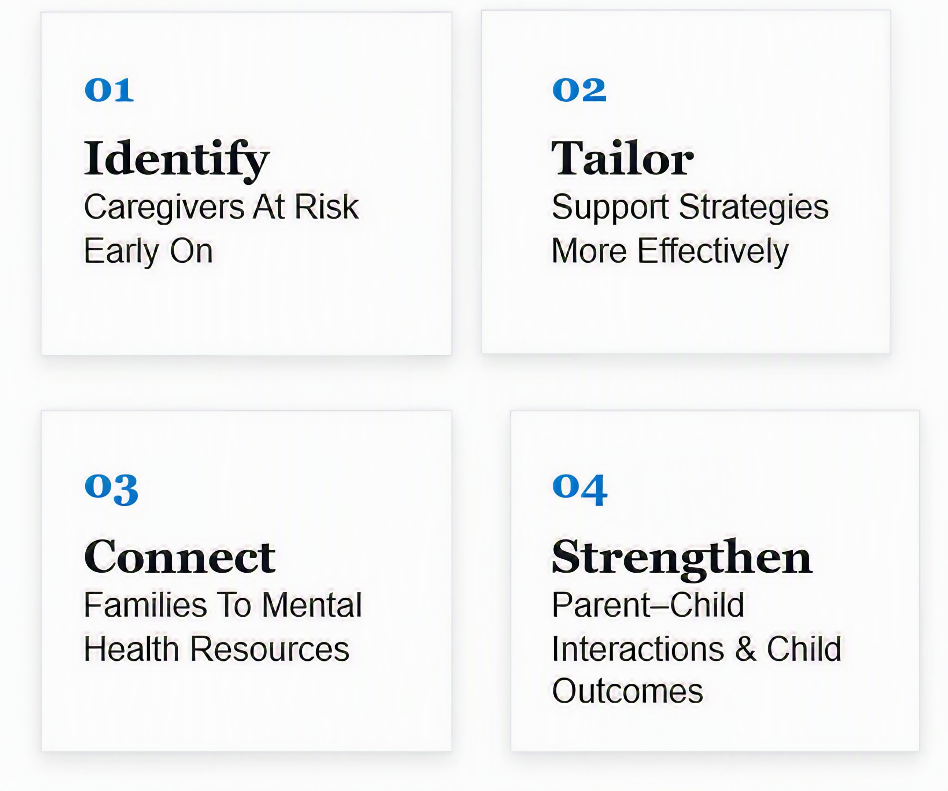
Screening for Depression and Anxiety Allows Home Visitors and Doulas to:
Notes:
“Screening for both conditions allows home visitors and doulas to:
Identify caregivers at risk early on;
Tailor support strategies more effectively;
Connect families to appropriate mental health resources; and
Strengthen parent-child interactions and child development outcomes.”
Reference:
“Updates to FY2027 MIECHV Performance Measures: Implementing the New Anxiety Screening and Completed Referral Measure: TA Tool for Anxiety Screening (01.30.26) FINAL”

Slide 8
From “Postpartum Depression” to
“Peripartum Depression”
In 2013:
  The term “postpartum depression” was changed to “peripartum depression” by the American Psychiatric Association in the 2013 Diagnostic and Statistical Manual Of Mental Disorders (DSM-5).
    Why the change?
      The term peripartum depression is used to classify depression that begins during pregnancy or in the weeks after delivery.
      Even though people still say “postpartum”, “the shift to ‘peripartum’ or ‘perinatal’ recognizes that symptoms often start before birth.”
  This information is to provide knowledge of the DSM verbiage. “Postpartum depression” is still a phrase that can be used.
Notes:
In 2013, the term “postpartum depression” was changed to “peripartum depression” by the American Psychiatric Association in the 2013 Diagnostic and Statistical Manual Of Mental Disorders (DSM-5).
Why was there a change?
It was changed since the term “peripartum depression” is used to classify depression that begins during pregnancy or in the weeks after delivery.
Even though people still say “postpartum”, “the shift to ‘peripartum’ or ‘perinatal’ recognizes that symptoms often start before birth.”
This information is to provide knowledge of the DSM verbiage. “Postpartum depression” is still a phrase that can be used.
Resources
1) Management of Postpartum Depression
Constance Guille, Roger Newman, Leah D Fryml, Clay K Lifton, C Neill Epperson
Corresponding Author: Constance Guille, M.D., Department of Psychiatry and Behavioral Sciences, Medical University of South Carolina, 67 President St. MSC861, 5 South, Charleston, SC 29425, Phone: (843) 792-6489, Fax: (843) 792-4190, guille@musc.edu
Issue date 2013 Nov-Dec.
2)Perinatal Depression
Karen Carlson ¹, Saba Mughal, Yusra Azhar ², Waquar Siddiqui
In: StatPearls [Internet]. Treasure Island (FL): StatPearls Publishing; 2026 Jan.
2025 Jan 22.
3) American Psychological Association: Perinatal Depression (formerly Postpartum)
https://www.psychiatry.org/patients-families/peripartum-depression
4) Postpartum (Peripartum) Depression: A Common but Treatable Condition
https://www.mylrh.org/postpartum-peripartum-depression-a-common-but-treatable-condition/

Slide 9
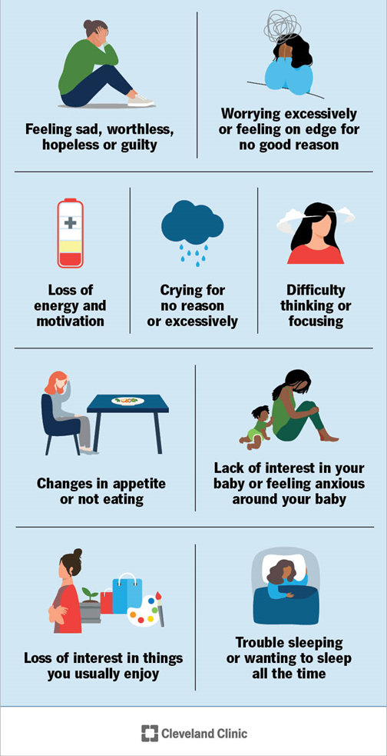
Peripartum/Postpartum Depression
Diagnostic and Statistical Manual of Mental Disorders (DSM-5)
American Psychiatric Association
Notes:
Symptoms of Peripartum Depression from the Diagnostic and Statistical Manual of Mental Disorders (DSM-5) - American Psychiatric Association include:
Feeling sad or having a depressed mood
Loss of pleasure or interest in activities that were once enjoyed
Trouble sleeping or sleeping too much
Loss of energy or increased fatigue (i.e., can’t get out of bed)
Crying for “no reason” or excessively
Feeling worthless, guilty, feeling overwhelmed and not being able to cope
Appetite changes (not eating or eating too much)
Feeling agitated and unable to sit still - or very slowed movement or speech
Difficulty thinking, concentrating or making decisions
Lack of interest in their baby, not feeling bonded to their baby or very anxious about/around the baby
Feelings of being a “bad” parent
Fear of harming the baby or oneself
Thoughts of death or suicide
Reference: Cleveland Clinic
https://my.clevelandclinic.org/health/diseases/9312-postpartum-depression

Slide 10
Many Postpartum Experiences Overlap, But They Are All Unique
Baby Blues: Very common. A temporary hormonal dip that brings tears, mood swings, and overwhelm in the first couple weeks. It usually fades on its own.
1
Postpartum/Peripartum Depression: Looks more like persistent sadness, low energy, or a caregiver having trouble bonding with their baby. It often lingers for months without support or treatment.
2
Postpartum Anxiety: Instead of deep sadness, it shows up as relentless worry. Caregivers might feel irritable and unable to sleep or relax—even when their baby is safe.
3
Notes:
Many Postpartum Experiences Overlap, But They Are All Unique:
Baby Blues: Very common. A temporary hormonal dip that brings tears, mood swings, and overwhelm in the first couple weeks. It usually fades on its own
Postpartum/Peripartum Depression: Looks more like persistent sadness, low energy, or a caregiver having trouble bonding with their baby. It often lingers for months without support or treatment.
Postpartum Anxiety: Instead of deep sadness, it shows up as relentless worry. Caregivers might feel irritable and unable to sleep or relax—even when their baby is safe.
Reference:
https://helpingmoon.com/when-worry-doesnt-quit-understanding-postpartum-anxiety

Slide 11
Why Does Anxiety Happen in Peripartum and Postpartum Stages of Life?
Hormone shifts after birth.
Stressors: Health challenges; financial pressures; changes in relationships.
Past pain: Miscarriage or pregnancy loss can heighten fears.
A history of anxiety or depression.
Changes in breastfeeding—especially during weaning.
Notes:
Why Does Anxiety Happen in Peripartum and Postpartum Stages of Life?
It may be due to the following:
- Hormone shifts after birth
Stressors, including health challenges, financial pressures, and/or changes in relationships when a baby is born.
Past pain, including miscarriages or pregnancy losses can heighten fears
A history of anxiety or depression
Changes in breastfeeding, especially during weaning
Reference:
https://helpingmoon.com/when-worry-doesnt-quit-understanding-postpartum-anxiety

Slide 12
Practice Evolves With The Evidence
As evidence and national guidelines have evolved, so too must program practices.
CURRENTLY:
AS OF OCTOBER 1, 2026:
Depression
Depression + Anxiety
Screening & Referral Measure
Updated Screening & Referral Measure
Edinburgh Postnatal Depression Scale | Anxiety Screening Update
4
Notes:
As evidence and national guidelines have evolved, so too must program practices. Consequently, HRSA is updating the current depression screening and referral measure to include anxiety.
Reference:
“Updates to FY2027 MIECHV Performance Measures: Implementing the New Anxiety Screening and Completed Referral Measure: TA Tool for Anxiety Screening (01.30.26) FINAL”

Slide 13
The Edinburgh Postnatal Depression Scale:
A HRSA-Approved Validated Scale
Literature Review
HRSA partnered with an independent research institute.
Environmental Scan
Identified current validated tools for depression and anxiety.
Validated Tools List
The Edinburgh was included for both depression and anxiety.
Illinois will continue using the Edinburgh — it meets the need to screen for depression and already contains questions that screen for anxiety.
Questions 3, 4, and 5 already address anxiety.
Edinburgh Postnatal Depression Scale | Anxiety Screening Update
6
Notes:
“To support this performance measure change, HRSA worked with an independent research institute to conduct a literature review and an environmental scan to identify current validated screening tools for depression and anxiety. The Edinburgh Postnatal Depression Scale was included in the list of validated screening tools for both depression and anxiety. Therefore, Illinois chose to continue using the Edinburgh because it fulfills the need for a tool to screen for depression and the screening tool also already contains 3 questions out of the 10 (questions 3, 4, and 5) that specifically address anxiety.”
Reference:
“Updates to FY2027 MIECHV Performance Measures: Implementing the New Anxiety Screening and Completed Referral Measure: TA Tool for Anxiety Screening (01.30.26) FINAL”

Slide 14
SAME Tool
Additional Scoring and Potential Referrals for Anxiety
UNCHANGED
NEW
ANXIETY SUBSCALE SCORE
The total score of questions 3, 4, and 5 determines if referral for anxiety is needed.
DEPRESSION SCORE
The total score of all 10 questions determines if referral for depression is needed.
Edinburgh Postnatal Depression Scale | Anxiety Screening Update
9
Notes:
“Since home visitors are already experienced in administering the tool to screen and refer for depression, programs will not need to learn an entirely new tool. What will change is the addition of a total score for questions 3, 4, and 5 to determine if there is a need for a referral specifically for anxiety. The overall score that includes the 10 questions used to determine if there is a need for a referral due to depression remains the same.”
Reference:
“Updates to FY2027 MIECHV Performance Measures: Implementing the New Anxiety Screening and Completed Referral Measure: TA Tool for Anxiety Screening (01.30.26) FINAL”

Slide 15
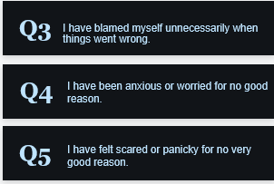
Questions 3, 4, and 5: Classified as the
“Anxiety Subscale” of the Edinburgh Postnatal Scale
What the Research Shows
Studies have validated the subscale’s use for detecting postpartum anxiety.
Edinburgh Postnatal Depression Scale | Anxiety Screening Update
8
Notes:
“Questions 3, 4, and 5 are classified as the “Anxiety Subscale” for the Edinburgh Postnatal Depression Scale. Studies have validated its use and have identified scoring cut-points for postpartum anxiety detection, which will be outlined in upcoming slides.”
Reference:
“Updates to FY2027 MIECHV Performance Measures: Implementing the New Anxiety Screening and Completed Referral Measure: TA Tool for Anxiety Screening (01.30.26) FINAL”

Slide 16
A Review of the Tool:
The Edinburgh Postnatal Depression Scale (EPDS)
J.L. Cox, J.M. Holden, R. Sagovsky,
Department of Psychiatry, University of Edinburgh
The Edinburgh Perinatal Depression Scale (EPDS) was developed in 1987.
The EPDS is a self-rating scale, which means you will ask parents to complete it during a visit.
Notes:
Let’s Take a Moment to Discuss the Actual Tool:
The Edinburgh Postnatal Depression (EPDS) Scale was first developed in 1987 by Scottish health centers in Edinburgh and Livingston. The EPDS is a 10-item questionnaire that was developed to identify women who have postpartum depression. The EPDS has proven to be an effective screening tool for not only postpartum but also pregnancy. It is a widely used depression screening tool and has been adapted and validated in many languages. Information on a link to access the tool in a variety of languages will be shared in an upcoming slide.
The EPDS is a self-rating scale, which means parents are asked to complete it during a visit, with home visitors and doulas scoring the tool as soon as parents complete it to provide immediate feedback and take any actions needed for resources and/or referrals.

Slide 17
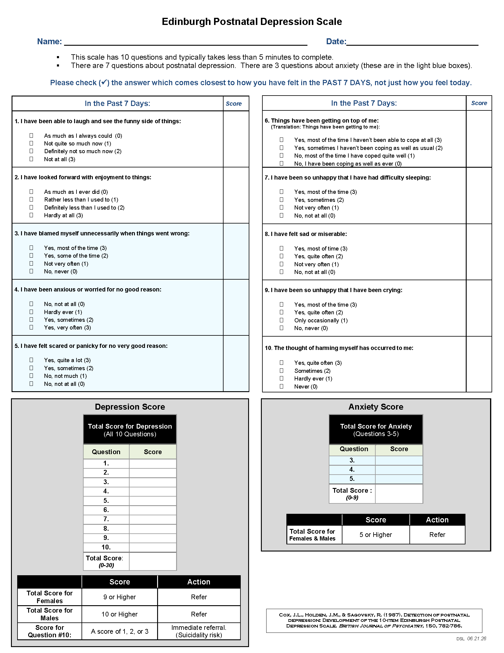
The Updated Tool
(English Version)
Programs will also have access to a Spanish version.
Notes:
On this slide is a snapshot of the English version of the revised tool home visitors and doulas will begin to use as of October 1, 2026. Based on copyright laws, the verbiage of the 10 questions has remained the same since the tool was first created in 1987.
When administering the Edinburgh Postnatal Depression Scale, HRSA recommends that the “screening should be administered in a private, comfortable location away from others” as much as possible. Additionally, when home visitors and doulas are discussing this mental health screening, HRSA recommends that home visitors frame the screening “as routine care for all participants” to normalize it for parents/caregivers.
Furthermore, programs should already have protocols and processes in place to handle “urgent situations” that may occur during home visits. Therefore, as a reminder to all of the program supervisors, please make a note to review the established protocol for home visits your program and/or agency has in place and make any updates or revisions needed to ensure home visitors and doulas know what should take place if an “urgent situation” occurs during a home visit.
A Spanish version is being developed that will be provided to all of your programs. Information to access to the scale in other languages is on the next slide.
Reference:
“Updates to FY2027 MIECHV Performance Measures: Implementing the New Anxiety Screening and Completed Referral Measure: TA Tool for Anxiety Screening (01.30.26) FINAL”

Slide 18

Access to the Edinburgh Postnatal Depression Scale in Multiple Languages
Link to resource for access to the Edinburgh Postnatal Depression Scale translated in other languages:
https://www.healthtranslations.vic.gov.au/resources/edinburgh-postnatal-depression-scale-epds
Notes:
The Edinburgh Postnatal Depression Scale is available in multiple languages by accessing the website on the slide (slides will be available to ensure all programs have the link).
https://www.healthtranslations.vic.gov.au/resources/edinburgh-postnatal-depression-scale-epds
Let’s review a tip sheet that provides an overview of the scale.
Resource:
https://www.healthtranslations.vic.gov.au/resources/edinburgh-postnatal-depression-scale-epds

Slide 19
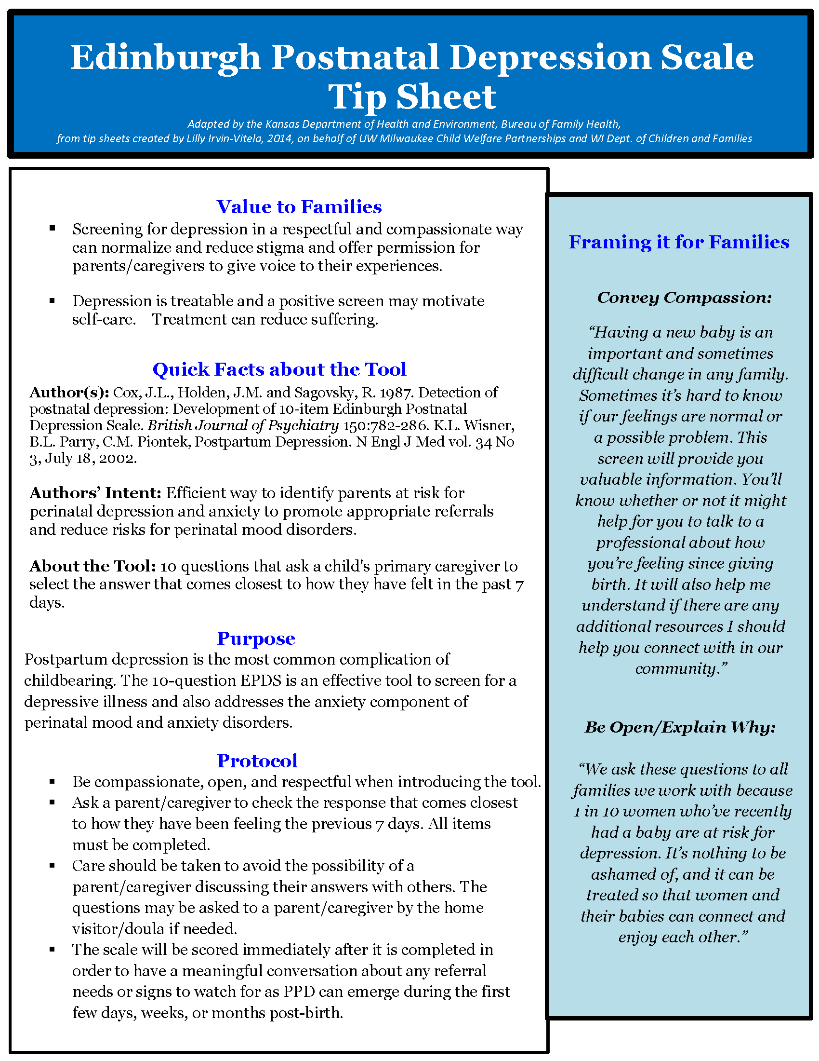
Notes:
The tip sheet on this slide provides a helpful overview on the value of the screening to families, quick facts about the tool, the purpose, protocol, and on the right side in the blue box are two samples on how home visitors and doulas can discuss the tool while conveying compassion and being open to explain why they are being asked to complete the screening.
Resource: Adapted by the Kansas Department of Health and Environment, Bureau of Family Health,
from tip sheets created by Lilly Irvin-Vitela, 2014, on behalf of UW Milwaukee Child Welfare Partnerships and WI Dept. of Children and Families

Slide 20
Edinburgh Postnatal Depression Scale
Name: _____________________________________________________ Date:________________
This scale has 10 questions and typically takes less than 5 minutes to complete.
There are 7 questions about postnatal depression. There are 3 questions about anxiety (these are in the light blue boxes).
Please check (✓) the answer which comes closest to how you have felt in the PAST 7 DAYS, not just how you feel today.
In the Past 7 Days: | Score
1. I have been able to laugh and see the funny side of things: As much as I always could (0) Not quite so much now (1) Definitely not so much now (2) Not at all (3)
2. I have looked forward with enjoyment to things: As much as I ever did (0) Rather less than I used to (1) Definitely less than I used to (2) Hardly at all (3)
3. I have blamed myself unnecessarily when things went wrong: Yes, most of the time (3) Yes, some of the time (2) Not very often (1) No, never (0)
4. I have been anxious or worried for no good reason: No, not at all (0) Hardly ever (1) Yes, sometimes (2) Yes, very often (3)
5. I have felt scared or panicky for no very good reason: Yes, quite a lot (3) Yes, sometimes (2) No, not much (1) No, not at all (0)
In the Past 7 Days: | Score
6. Things have been getting on top of me: (Translation: Things have been getting to me): Yes, most of the time I haven’t been able to cope at all (3) Yes, sometimes I haven’t been coping as well as usual (2) No, most of the time I have coped quite well (1) No, I have been coping as well as ever (0)
7. I have been so unhappy that I have had difficulty sleeping: Yes, most of the time (3) Yes, sometimes (2) Not very often (1) No, not at all (0)
8. I have felt sad or miserable: Yes, most of time (3) Yes, quite often (2) Not very often (1) No, not at all (0)
9. I have been so unhappy that I have been crying: Yes, most of the time (3) Yes, quite often (2) Only occasionally (1) No, never (0)
10. The thought of harming myself has occurred to me: Yes, quite often (3) Sometimes (2) Hardly ever (1) Never (0)
Notes:
In order for you to view the specifics of the tool, the upper half will be shown on this slide, and the lower half on the next slide.
As the tool is introduced to a parent/caregiver during a visit, please remember the guidelines from HRSA that I just mentioned on the previous slide, which I will repeat so you can all hear them again:
HRSA recommends that the “screening should be administered in a private, comfortable location away from others” as much as possible. Additionally, when home visitors and doulas are explaining the screening, HRSA recommends that home visitors and doulas frame the screening “as routine care for all participants” to normalize it as much as possible.
Let’s walk through the process of administering the tool to a parent/caregiver.
Imagine yourself at a home visit.
Begin explaining the screening by using the verbiage on the tip sheet in your own words that this mental health screening tool is called the Edinburgh Postnatal Depression Scale (and is called this because it was created in a city in Scotland called Edinburgh). It was created to ask a parent/caregiver questions about their mental health, including questions about postnatal depression and questions about postnatal anxiety.
Provide a paper copy of the tool to the primary parent/caregiver. Ask them to write their name and the date.
(If you notice this might be difficult for them, you may ask their permission to write their name and the date on it.
You will then verbally review the instructions with them. The instructions include the following: “This scale has 10 questions and typically take less than 5 minutes to complete. There are 7 questions about postnatal depression. There are 3 questions about anxiety (these are in the light blue boxes.) Please read each question and check the answer which comes closest to how you have felt in the past 7 days, not just how you feel today. Again, after reading each question, check the answer which comes closes to how you have felt in the past 7 days, not just how you feel today.”
You will give them time to complete the scale.
Reference:
“Updates to FY2027 MIECHV Performance Measures: Implementing the New Anxiety Screening and Completed Referral Measure: TA Tool for Anxiety Screening (01.30.26) FINAL”

Slide 21
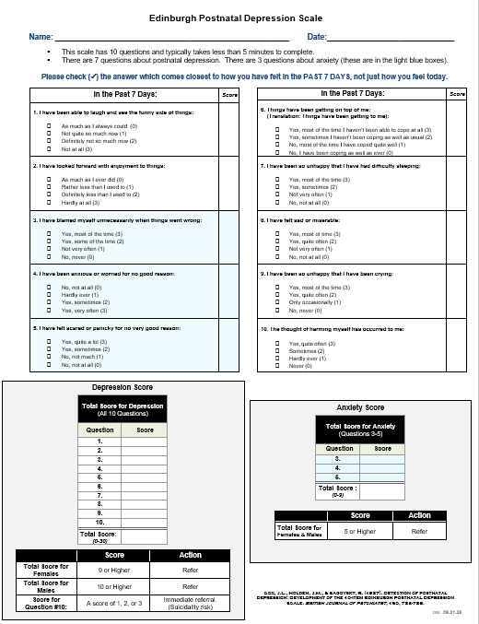
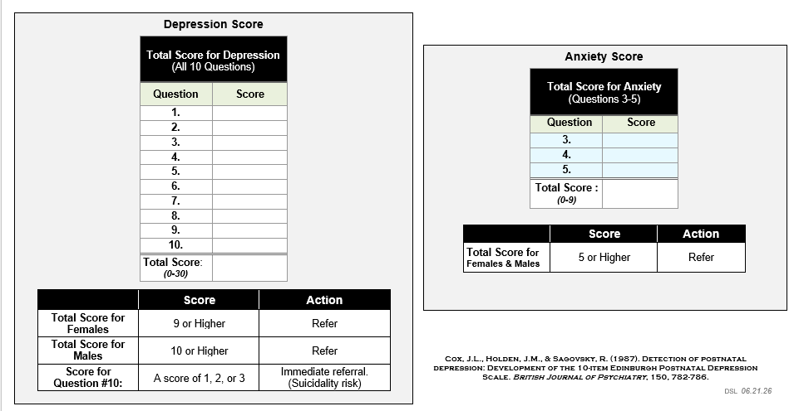
Calculating a Score for Depression
Notes:
After a caregiver has finished marking each question, home visitors and doulas will calculate a score to determine if there is a need to refer based on depression and will also calculate a score to determine if there is a need to refer based on anxiety.
Calculating a Score for Depression:
On this slide, we will discuss calculating a score for depression.
When calculating a score for depression, the score from all 10 questions will be copied into the “Depression Score” chart, with a total score determined based on the sum.
Scores will range from 0-30.
If the primary caregiver is a female and scores 9* or higher, the action will be for home visitors and doulas to refer to services according to their established protocol, and obtain consent for referral follow-up, per the “Updates to FY2027 MIECHV Performance Measures: Implementing the New Anxiety Screening and Completed Referral Measure: TA Tool for Anxiety Screening (01.30.26) FINAL.”
If the primary caregiver is a male and the total score is 10 or higher, the action will be for home visitors and doulas to refer to services according to their established protocol, and obtain consent for referral follow-up, per the “Updates to FY2027 MIECHV Performance Measures: Implementing the New Anxiety Screening and Completed Referral Measure: TA Tool for Anxiety Screening (01.30.26) FINAL.”
If the score for questions #10 is a score of 1, 2, or 3, an immediate referral is needed due to the risk of suicidality.
* Depression Score Reference (9 or Higher)
PA PsycTests: Citation and Description
Edinburgh Postnatal Depression Scale
Cox, J. L., Holden, J. M., & Sagovsky, R. (1987). Edinburgh Postnatal Depression Scale (EPDS) [Database record]. APA PsycTests.
https://doi.org/10.1037/t01756-000
Description
The Edinburgh Postnatal Depression Scale (EPDS; Cox, Holden, & Sagovsky, 1987) was developed for screening postpartum women in outpatient, home visiting settings, or at the 6-8 week postpartum examination.
Validation studies have utilized various threshold scores in determining which women were positive and in need of referral. Cut-off scores ranged from 9 to 13 points. Therefore, to err on safety's side, a woman scoring 9 or more points or indicating any suicidal ideation—that is she scores 1 or higher on question #10—should be referred immediately for follow-up. Even if a woman scores less than 9, if a professional feels the client is suffering from depression, an appropriate referral should be made. (PsycTests Database Record (c) 2026 APA, all rights reserved)
Reference:
“Updates to FY2027 MIECHV Performance Measures: Implementing the New Anxiety Screening and Completed Referral Measure: TA Tool for Anxiety Screening (01.30.26) FINAL”

Slide 22
Calculating a Score for Anxiety
Notes:
Calculating a Score for Anxiety:
On this slide, we will discuss calculating a score for anxiety.
When calculating a score for anxiety, the scores from questions 3, 4, and 5 will be copied into the “Anxiety Score” chart, with a total score determined based on the sum.
Scores will range from 0-9
If the total score for females and males is 5* or higher, the action will be for home visitors and doulas to refer to services according to their established protocol, and obtain consent for referral follow-up, per the “Updates to FY2027 MIECHV Performance Measures: Implementing the New Anxiety Screening and Completed Referral Measure: TA Tool for Anxiety Screening (01.30.26) FINAL.”
*Anxiety Score References (5 or higher for females & males)
- PubMed article referenced by HRSA: Using the Edinburgh Postnatal Depression Scale to screen for anxiety disorders – PubMed
https://pubmed.ncbi.nlm.nih.gov/18041072/
- Joint EDPS-3A Discussion and Plan Meeting (05.26.26: 2-3 p.m.): As confirmed by Jeni Weisiger, T. Small recommended the score of 5 or higher for females and males.
Reference:
“Updates to FY2027 MIECHV Performance Measures: Implementing the New Anxiety Screening and Completed Referral Measure: TA Tool for Anxiety Screening (01.30.26) FINAL”

Slide 23
Building A List of Resources For Anxiety Referrals
ASSEMBLE IN ADVANCE
1
2
3
4
Local & Community Resources
Providers and programs caregivers can access.
Warm Lines
Non-crisis support and listening lines.
Telehealth Options
Virtual access to mental health support.
And More
Other sources of support & information.
Edinburgh Postnatal Depression Scale | Anxiety Screening Update
13
Notes:
Before home visitors and doulas administer any screening tool, they must ensure they have resources with them to share with parents/caregivers related to the screening theme.
Therefore, just as home visiting programs have had to research and make connections with local and community resources to make referrals for depression, one added task for home visiting teams to in their preparation to begin screening for anxiety is to research and create a list of local and community resources, telehealth options, warm lines, etc.

Slide 24
Provide Resources On Emotional Wellness And Stress Management To All Families
  HV Model Curriculum Materials
  Mothers and Babies Program
Edinburgh Postnatal Depression Scale | Anxiety Screening Update
11
Notes:
Regardless of the screening outcome, HRSA recommends that home visiting programs continue to provide resources and education on emotional wellness and stress management to all families.
Programs can do this by utilizing the materials and resources that have been included in your home visiting model curriculum.
Another valuable resource that home visiting programs can access is the Mothers and Babies Program, which is explained further on the next slide.
Reference:
“Updates to FY2027 MIECHV Performance Measures: Implementing the New Anxiety Screening and Completed Referral Measure: TA Tool for Anxiety Screening (01.30.26) FINAL”

Slide 25

The Mothers and Babies Program
:
The Mothers and Babies Program is an evidence-based intervention for pregnant people and new parents to help manage stress and prevent postpartum depression.
_________________________________________________________
The content includes:
    Support for healthy communication,
    Support for stress management, and
    Support for healthy bonding with your baby.
The Mothers and Babies program is based on the principles of cognitive-behavioral therapy (CBT), attachment theory, and psychoeducation, and can be delivered during home visits or in a group format.
For more information about Mothers & Babies:
Website: www.mothersandbabiesprogram.org
  Email: mothersandbabies@northwestern.edu
Notes:
The Mothers and Babies Program is an evidence-based intervention for pregnant people and new parents to help manage stress and prevent postpartum depression. It is an interactive program that shares useful tools and skills to help manage stress and/or reduce symptoms of depression. The Mothers and Babies Program through Northwestern University has worked closely with home visiting programs in Illinois since 2014. If your program has not been trained and/or would like to be re-trained, please contact the program at the information listed on the slide.
The content includes:
Support for healthy communication, stress management, and healthy bonding with your baby.
Helpful information about your pregnancy and your baby's development.
Strategies, including mindfulness practices, for paying attention to your mood.
The Mothers and Babies program is based on the principles of cognitive-behavioral therapy (CBT), attachment theory, and psychoeducation, and can be delivered during home visits or in a group format.
.
Reference:
Mothers and Babies Website: www.mothersandbabiesprogram.org

Slide 26

Built-In Support:
Your Infant & Early Childhood Mental Health Consultant
Edinburgh Postnatal Depression Scale | Anxiety Screening Update
14
Notes:
A built-in infrastructure of support for home visiting programs exists through each program’s Infant & Early Childhood Mental Health Consultant. In addition to providing reflective consultation to build and enhance the capacity of your home visiting program, your consultant can translate the administration of the Edinburgh into practice. These reflective opportunities allow home visiting programs to reflect on the dynamics of relationships with parents/caregivers; the challenges of having difficult conversations; the nuances of making referrals based on the administration of the Edinburgh; and the potential stigmas associated with mental health topics such as depression and anxiety.

Slide 27

Providing Screenings is Crucial
Home visitors and doulas provide a critical layer of prevention, detection, and connections to resources and referrals through screenings that improve the health and well-being of parents, children, and families.
Notes:
Providing Screenings is Crucial
Home visitors and doulas provide a critical layer of prevention, detection, and connections to resources and referrals through screenings that improve the health and well-being of parents, children, and families.
Reference:
Perinatal Depression
Karen Carlson 1, Saba Mughal, Yusra Azhar 2, Waquar Siddiqui
In: StatPearls [Internet]. Treasure Island (FL): StatPearls Publishing; 2026 Jan.
2025 Jan 22.
Affiliations Expand
PMID: 30085612 Bookshelf ID: NBK519070
Free Books & Documents

Slide 28
Conclusion
“The FY2027 updates to the MIECHV performance measures strengthen existing home visiting practices by formally integrating anxiety screening and completed anxiety referrals into program requirements. These changes reflect the growing evidence that anxiety is both common and distinct from depression among caregivers of infants and young children, and that early detection is essential for supporting healthy parent-child relationships and child development.”
“Updates to FY2027 MIECHV Performance Measures Implementing the New Anxiety Screening and Completed Referral Measure”
Notes:
“The FY2027 updates to the MIECHV performance measures strengthen existing home visiting practices by formally integrating anxiety screening and completed anxiety referrals into program requirements. These changes reflect the growing evidence that anxiety is both common and distinct from depression among caregivers of infants and young children, and that early detection is essential for supporting healthy parent-child relationships and child development.
Reference:
“Updates to FY2027 MIECHV Performance Measures: Implementing the New Anxiety Screening and Completed Referral Measure: TA Tool for Anxiety Screening (01.30.26) FINAL”

Slide 29

“Home visitors and doulas already play a vital role in promoting caregiver well-being, and the addition of anxiety screening helps programs more fully address the mental health conditions that shape family functioning in the earliest years.”
Notes:
“Home visitors (and doulas) already play a vital role in promoting caregiver well-being, and the addition of anxiety screening helps programs more fully address the mental health conditions that shape family functioning in the earliest years.”
Reference:
“Updates to FY2027 MIECHV Performance Measures: Implementing the New Anxiety Screening and Completed Referral Measure: TA Tool for Anxiety Screening (01.30.26) FINAL”

Slide 30
Resources

Slide 31


In Addition to Your Local Resources
State Resources Are Available:
211 Illinois
https://211illinois.org/
Notes:
In Addition to Your Local Resources, State Resources Are Available:
211 Illinois
https://211illinois.org/

Slide 32

In Addition to Your Local Resources
State Resources Are Available:
Beacon
https://beacon.illinois.gov/
Notes:
In Addition to Your Local Resources, State Resources Are Available:
Beacon:
A centralized resource for IL youth and families seeking services for behavioral health needs.
https://beacon.illinois.gov/

Slide 33
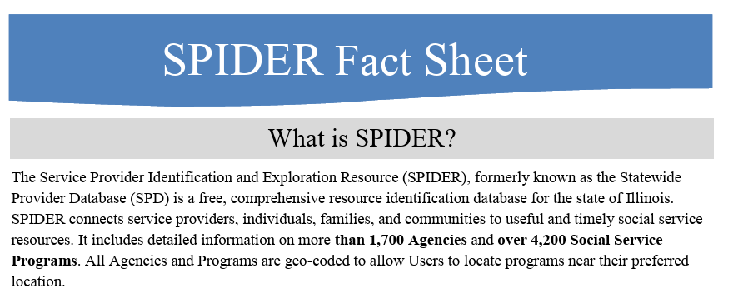
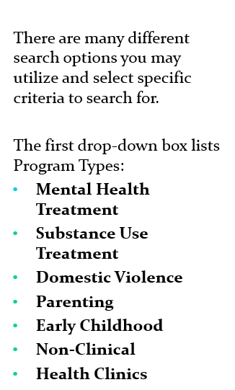
In Addition to Your Local Resources
State Resources Are Available:
SPIDER
https://spider.dcfs.illinois.gov/Search/SearchAgency
Notes:
In Addition to Your Local Resources, State Resources Are Available:
SPIDER:
The Service Provider Identification and Exploration Resource (SPIDER), formerly known as the Statewide Provider Database (SPD) is a free, comprehensive resource identification database for the state of Illinois. SPIDER connects service providers, individuals, families, and communities to useful and timely social service resources. It includes detailed information on more than 1,700 Agencies and over 4,200 Social Service Programs. All Agencies and Programs are geo-coded to allow users to locate programs near their preferred location.
https://spider.dcfs.illinois.gov/Search/SearchAgency

Slide 34
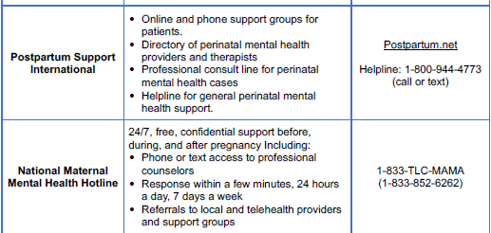
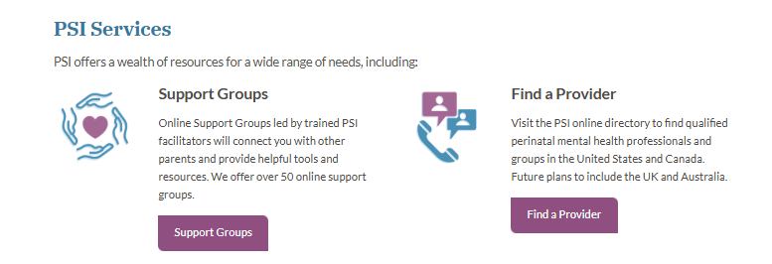
In Addition to Your Local Resources
National Resources Are Available:
Postpartum Support
International
https://postpartum.net/get-help/
Notes:
In Addition to Your Local Resources, National Resources Are Available:
Postpartum Support International
Reference:
“Updates to FY2027 MIECHV Performance Measures: Implementing the New Anxiety Screening and Completed Referral Measure: TA Tool for Anxiety Screening (01.30.26) FINAL”

Slide 35
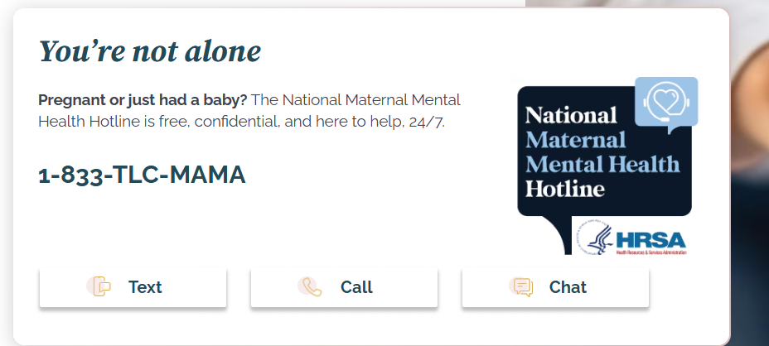
In Addition to Your Local Resources
National Resources Are Available:
National Maternal
Mental Health Hotline
https://mchb.hrsa.gov/programs-impact/national-maternal-mental-health-hotline
Notes:
In Addition to Your Local Resources, National Resources Are Available:
National Maternal Mental Health Hotline
Reference:
“Updates to FY2027 MIECHV Performance Measures: Implementing the New Anxiety Screening and Completed Referral Measure: TA Tool for Anxiety Screening (01.30.26) FINAL”

Slide 36

In Addition to Your Local Resources
National Resources Are Available:
988 Lifeline
https://988lifeline.org/
Notes:
In Addition to Your Local Resources, National Resources Are Available:
988 Lifeline:
https://988lifeline.org/
Reference: Request by Laura Beavers, IDEC, on 07.06.26.

Slide 37
References

Slide 38
References
Collier, S, MD, Ph.D. (2021, July 30). Postpartum Anxiety is Invisible, but Common and Treatable. Harvard Health Publishing. https://www.health.harvard.edu/blog/postpartum-anxiety-an-invisible-disorder-that-can-affect-new-mothers-202107302558
Cox, J. L., Holden, J. M., & Sagovsky, R. (1987). Edinburgh Postnatal Depression Scale (EPDS) [Database record]. APA PsycTests. https://doi.org/10.1037/t01756-000
Cox, J.L.; Holden, J.M., Sagovsky, R. (1987). Detection Of Postnatal Depression. Development Of The 10-item Edinburgh Postnatal Depression Scale. British Journal of Psychology;150:782-6. doi: 10.1192/bjp.150.6.782. https://pubmed.ncbi.nlm.nih.gov/3651732/
Department of Health, Government of Western Australia. (2006). Edinburgh Postnatal Depression Scale (EPDS): Translated versions – Not Validated. Perth, Western Australia: State Perinatal Mental Health Reference Group. https://www.dchealthcheck.net/documents/10-2015-EPDS-Translations.pdf
Continued…

Slide 39
References (Continued)
Furtado M, Van Lieshout RJ, Van Ameringen M, Green SM, Frey BN. Biological And Psychosocial Predictors Of Anxiety Worsening In The Postpartum Period: A Longitudinal Study. J Affect Disord. 2019 May 1;250:218-225. doi: 10.1016/j.jad.2019.02.064. Epub 2019 Mar 1. PMID: 30870771.
Health Resources & Services Administration. (2026). “Updates to FY2027 MIECHV Performance Measures: Implementing the New Anxiety Screening and Completed Referral Measure: TA Tool for Anxiety Screening (01.30.26) FINAL”
Kansas Department of Health and Environment, Bureau of Family Health, (Adapted from Tip sheets created by Lilly Irvin-Vitela, 2014), on behalf of UW Milwaukee Child Welfare Partnerships and WI Dept. of Children and Families.
Matheny, Stephen. (2008) Using The Edinburgh Postnatal Depression Scale To Screen For Anxiety Disorders. https://pubmed.ncbi.nlm.nih.gov/18041072/. https://pubmed.ncbi.nlm.nih.gov/18041072/
Mothers and Babies Program: www.mothersandbabiesprogram.org
Continued…

Slide 40
References (Continued)
Nonacs,R. MD PhD (2008, October 27). Identifying Post Partum Depression: A Three Question Screening Tool. MGH Center for Women’s Mental Health. https://womensmentalhealth.org/posts/screening-for-peripartum-anxiety-disorders-what-are-the-best-screening-tools/
Nonacs, R. MD PhD (2015, September 30). Is it Postpartum Depression or Postpartum Anxiety? What’ s the Difference? MGH Center for Women’s Mental Health. https://womensmentalhealth.org/posts/is-it-postpartum-depression-or-postpartum-anxiety-whats-the-difference
Screening for Anxiety Disorders During Pregnancy and the Postpartum Period. MGH Center for Women's Mental Health. https://womensmentalhealth.org/posts/screening-perinatal-anxiety-2/
Torres, F (2020, October). What is Postpartum Depression? American Psychiatric Association. https://www.psychiatry.org/patients-families/postpartum-depression/what-is-postpartum-depression

Slide 41
End.

Slide 42
The 10 Questions on the Tool
Edinburgh Postnatal Depression Scale
Name: _____________________________________________________ Date:________________
This scale has 10 questions and typically takes less than 5 minutes to complete.
There are 7 questions about postnatal depression. There are 3 questions about anxiety (these are in the light blue boxes).
Please check (✓) the answer which comes closest to how you have felt in the PAST 7 DAYS, not just how you feel today.
In the Past 7 Days: | Score
1. I have been able to laugh and see the funny side of things: As much as I always could (0) Not quite so much now (1) Definitely not so much now (2) Not at all (3)
2. I have looked forward with enjoyment to things: As much as I ever did (0) Rather less than I used to (1) Definitely less than I used to (2) Hardly at all (3)
3. I have blamed myself unnecessarily when things went wrong: Yes, most of the time (3) Yes, some of the time (2) Not very often (1) No, never (0)
4. I have been anxious or worried for no good reason: No, not at all (0) Hardly ever (1) Yes, sometimes (2) Yes, very often (3)
5. I have felt scared or panicky for no very good reason: Yes, quite a lot (3) Yes, sometimes (2) No, not much (1) No, not at all (0)
In the Past 7 Days: | Score
6. Things have been getting on top of me: (Translation: Things have been getting to me): Yes, most of the time I haven’t been able to cope at all (3) Yes, sometimes I haven’t been coping as well as usual (2) No, most of the time I have coped quite well (1) No, I have been coping as well as ever (0)
7. I have been so unhappy that I have had difficulty sleeping: Yes, most of the time (3) Yes, sometimes (2) Not very often (1) No, not at all (0)
8. I have felt sad or miserable: Yes, most of time (3) Yes, quite often (2) Not very often (1) No, not at all (0)
9. I have been so unhappy that I have been crying: Yes, most of the time (3) Yes, quite often (2) Only occasionally (1) No, never (0)
10. The thought of harming myself has occurred to me: Yes, quite often (3) Sometimes (2) Hardly ever (1) Never (0)

